Slide 1
MEDICINE SAFETY
with the Arizona Poison Control System
Notes:
Introduce yourself
Cover any housekeeping before starting the presentation (eg, where bathrooms are, if people can ask questions during the presentation or should wait until the end, etc)
Please administer pre-tests (verbally or printed) if possible.

Slide 2

Why are we here today?
Compared to others, older adults tend to:
take more medicines
see more doctors
have more adverse drug reactions
Notes:
Medicine safety is important for people of ALL ages but older adults are more vulnerable for a variety of reasons. In general, the older we get, the more health concerns we have, the more doctors we see, and the more medicines we need.
The fact that you’re sitting in this room today means that you already care about taking your medicines safely. So, most of what we’re going to do today will involve discussing how to do that.
NOTE: Should let attendees know that “We are here to have a general conversation about how we can all store and take our medicines safely. I am not here to answer any specific questions you may have about your specific medicines or your conditions.”
If people still try to ask questions related to their own medications, you can let them know that they can call the Poison Center (1-800-222-1222)

Slide 3
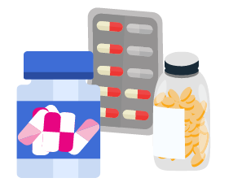
Quick Review: Types of Medicine
Prescription medicines
Over-the-counter (OTC)
Vitamins
Herbal supplements
Homeopathic remedies
Notes:
You’re probably here because you take medicine, or you help someone who takes medicine. Many people take at least one medicine regularly, including over-the-counter medicines, prescription medicines, and vitamins or supplements.
About one-third of adults 57 years and older use at least 5 different prescription medicines, and most older adults taking prescription medicines are also using over-the-counter medicines, dietary supplements, or both.
We take all of these medicines to stay healthy. But more medicines can mean more potential risks and mistakes. If you take a lot of medicines like so many older adults do, it can be confusing to keep them straight. Think to yourself for a moment about how you keep your medicines organized. Are they in a big box or a bag? Do you use pill sorters?

Slide 4
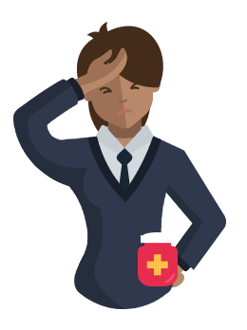
Side effects are one kind of adverse drug event
Notes:
Even though medicines can help us, when we take the wrong amount of medicine, take our medicines at the wrong time, or take different medicines that interact with each other, our medicines can actually be harmful.
Have you ever heard of “side effects”? For example, some medicines can give people a really bad headache. Whenever someone is harmed by a medicine it’s called an ‘adverse drug event.’
You or someone you know may have had one of these adverse drug events before. They can be harmful, especially for older adults. Did you know that medicine mishaps like interactions and side effects cause over 700,000 emergency department visits each year? Because as we age we typically take more medicines, older adults are twice as likely as others to come to emergency departments for problems with their medicines, and nearly seven times more likely to be hospitalized after an emergency visit.

Slide 5
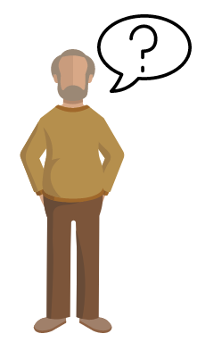
What would you do if you took the wrong medicine or too much medicine?
Notes:
Here is the good news – there are things everyone can do to help prevent many medicine issues. We are going to talk about those things today and discuss who we can talk to if something bad does happen with our medicines.
Think about this for a moment - what would you do if you accidentally took the wrong medicine, or took too much medicine? What would you do if one of your grandchildren got into your medicine?

Slide 6
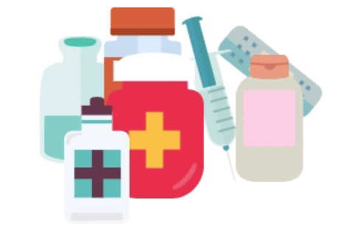
Medicines are NOT just pills
Notes:
It’s important that every time someone says ‘medicine’ today we’re all talking about the same thing. Think of a medicine as any substance that is meant to create a change in the body. Medicines can relieve symptoms like pain or fever, or they can treat disease, like antibiotics do. Medicine can be a patch, powder, cream, drop, spray, injectable liquid, or a liquid you’re supposed to swallow. Think for a moment about all of the medicines in your house that aren’t pills.

Slide 7
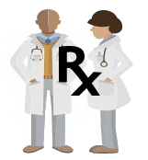
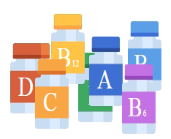
Types of Medicine
Prescription medicines are prescribed by your doctors.
Over-the-counter (OTC) medicine:
No prescription needed.
Notes:
There are two main types of medicines. First, there are prescription medicines. A prescription medicine is one that you cannot get unless a doctor or a nurse practitioner prescribes it for you. These are the medicines that you get directly from your doctor’s office, from a pharmacist, or by mail from an online pharmacy. Think to yourself for a moment about all of your prescription medicines. Chances are some of you take at least three of these.
Next, there are over-the-counter medicines. We don’t need a prescription for over-the-counter medicines. Over-the-counter medicines are generally safe when taken as directed on the Drug Facts Label. However, that doesn’t mean that they can’t harm us if we take them incorrectly. Most people in this room probably take an over-the-counter medicine, at least from time to time.
Finally, I must mention vitamins, herbal remedies, and supplements. Vitamins and supplements can interact with medicines, or change the way medicines are supposed to work. An example of a supplement is glucosamine, which some people take to help their joints. Think for a moment about any vitamins or supplements that you take.

Slide 8
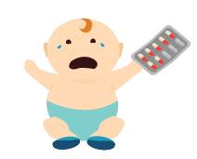
Any substance can be poisonous…
…if used by the wrong person, in the wrong way, or at the wrong time.
Notes:
People can call the Poison Center when they think they or someone else may have been poisoned, or if they have questions. It may surprise you to hear that any substance, including things that are supposed to help you, like medicines, can be poisonous if they are used by the wrong person or in a way other than directed by the label. For example, certain medicines may help you stay healthy, but can be very harmful for your grandchildren if they take them.
Think for a moment about where you keep your medicines. If you have grandchildren, do you keep your medicines somewhere that your grandchildren cannot get to them?

Slide 9
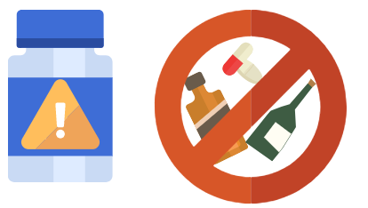
Medicines can be poisonous…
…if taken in a way other than as directed on the label, or if you take a medicine that isn’t right for you.
Notes:
Medicines can also be poisonous if you take too much, take them in the wrong way, or if you take a medicine that isn’t right for you. For example, some people need blood thinners to stay healthy. But taking too many can be very harmful. Another example: some medicines should not be taken with alcohol. Even certain juices or beverages with caffeine like coffee and tea can change the way your medicines work.
Every year, the nation’s 55 poison centers help over a million people who have taken too much medicine, the wrong medicine, or are experiencing an adverse event from medicine. People also call poison centers because they have questions about their medicines. Before you leave today I’ll make sure you have the Poison Help number in case you ever need it

Slide 10
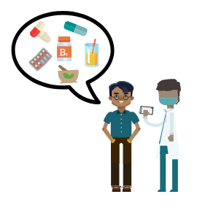
#1: Participate!
It’s your health.
Notes:
Next we’re going to talk about a few specific ways you can help prevent problems with your medicines, and who you can talk to if you do make a mistake, need information, or have any concerns about your medicines. There are 5 main things I want you to remember when you leave this room today.
First, participate. Be an active, assertive participant in your own healthcare. Make a point of discussing ALL your medicines with your doctors and anyone who helps you with your medical care. If you have questions about your medicines like how much to take or why you’re taking it, do not guess!

Slide 11
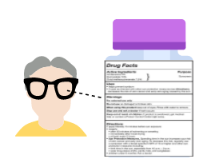
#2: READ & FOLLOW the entire label.
Notes:
Second, always read and follow the entire medicine label, including on over-the-counter medicines. Make sure you know how much medicine to take, how often to take it, and whether there are certain foods, beverages, or other medicines you should avoid while taking your medicine.

Slide 12

#3: Write it down.
Notes:
Third, keep an up-to-date list of all of the medicines that you are taking – including prescription medicine, over-the-counter medicine, and vitamins or supplements – bring the list with you whenever you go to a healthcare professional or drugstore. This is especially important if you take a lot of different medicines.

Slide 13
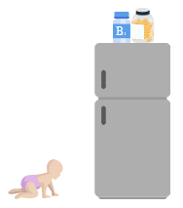
#4: Keep medicine up, away, and out of sight!
Notes:
Fourth, to reduce the chance that someone gets into your medicine, keep your medicines up, away, and out of sight of children & teens, adult visitors, and pets.

Slide 14
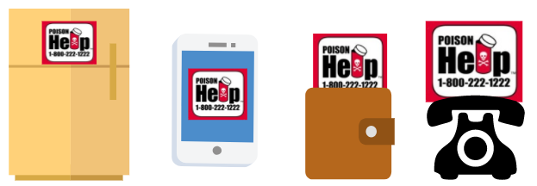
#5: Be prepared.
Know who to call.
Notes:
Lastly, be prepared by knowing who to call. Save the Poison Help number in your phone and display it somewhere visible in your house, like on the refrigerator or close to your landline telephone or computer. The number is 1-800-222-1222. You have it on [stickers and/or magnets] we’re going to give you at the end of today’s session. Also, keep numbers for all of your doctors and your pharmacy in one place, preferably on an up-to-date list of all of the medicines that you take.
I know that was a lot of information to hear all at once. Thank you for being patient with me while I got through all that. Don’t worry, we’re going to talk about everything again and I want to hear what you have to say about how you make sure you’re taking your medicines safely.

Slide 15
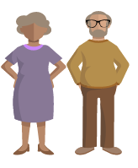
Meet Judy and Ron.
Notes:
Read or paraphrase: “Judy and Ron have just celebrated their 40th wedding anniversary. Judy has high blood pressure, diabetes, and arthritis. Ron has had some blood clots and he has allergies. Like a lot of older adults and probably some of you, Ron and Judy each take a few different vitamins, over-the-counter medicines, and several prescription medicines.”
Scenario 1: Pill sorters and medicine mix-up - Covers safe storage and being prepared by knowing who to call
Read or paraphrase: “Ron and Judy both keep their medicines in pill sorter boxes. They keep the pill sorter boxes on the kitchen counter. Ron has poor eyesight. One morning, Ron accidentally takes the pills from Judy’s pill sorter box. He does not realize what he has done until Judy asks him what happened to her pills. How do you keep your medicines organized?”
Discuss. Ensure the following points are made:
Pill sorters should be kept up and away and out of reach of kids.
Make sure your pill sorter is different from everyone else’s in your house, or clearly marked as yours.
If you keep your medicine in your purse, consider using a child-resistant pill box. Never store medicine in baggies because kids equate baggies with treats.
Read or paraphrase: “What would you do if you were Ron and Judy in this situation, and why?”
Discuss. Ensure the following points are made:
It can be harmful to take someone else’s prescription medicine because of potential interactions, allergies, and other potential adverse events.
This is a great example of a reason to call the Poison Center; point out stickers and/or magnets that will be given to participants.
If you put over-the-counter pills in a pill sorter or anything other than the original packaging, be sure to keep the original packaging so you can refer to the label and instructions. This will help if you need to call the Poison Center.

Slide 16
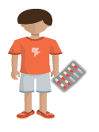
Ron & Judy’s grandson gets into Judy’s medicine
Notes:
Scenario 2: Child gets into your medicine - covers safe storage and being prepared by knowing who to call
Read or paraphrase: “Judy and Ron take care of their 3-year-old grandson, Oliver, in their home two or three times a week while their daughter works. One morning, Judy goes to the kitchen to make some coffee. When she comes back to the living room, she finds Oliver sitting on the couch with her open purse, holding some of her pills in his hand. Judy can’t tell for sure if he has swallowed any of the pills, but he is acting normally, so Judy isn’t sure if it’s an emergency or not.”
Let me start our discussion by saying this: 1 in 10 kids are living with a grandparent, and 13 percent of grandparents are relied on to be a trusted caregiver. Does anyone here either live with or take care of grandchildren sometimes?
Read or paraphrase: “A couple of years ago a study found that in over a third of cases where a child got into someone’s medicine and went to the emergency room, the medicine belonged to a grandparent. That’s one in three! Why do you think it can be harmful for kids to take their grandparents’ medicines?”
Discuss; ensure that the following point is made:
Medicine that is meant for adults can be very harmful when a child takes it because kids’ bodies process medicine differently than adults, plus they weigh a lot less. Children are not just small versions of adults when it comes to medicines!
Read or paraphrase: “What would you do if one of your grandchildren or a child that comes to visit you got into your medicine?”
Discuss; ensure the following point is made:
One can call the Poison Center in this scenario.
Read or paraphrase: “What could Judy do differently to help prevent this from happening again?”
Discuss; ensure the following points are made:
The best way to store medicine is up, away, out of sight of kids. If you must keep medicines in your purse, keep your medicine in child-resistant containers and keep your purse up, away, out of sight.
Child-resistant packaging should not be used as a substitute for keeping medicines out of reach of kids. There is no such thing as “child-proof!”

Slide 17
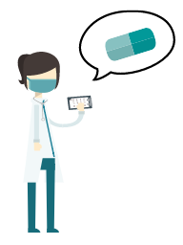
Judy can’t remember all of her medicines, and her doctor gives her a new one.
Notes:
Scenario 3: Forgot to tell doctor about medicine; doctor prescribes a new medicine. - Covers being an active participant), following labels and instructions, writing down medicines, and being prepared by knowing who to call.
Read or paraphrase: “Last month, Judy had appointments to see her regular family doctor who checks her blood pressure, another doctor for her diabetes, and a third doctor for her arthritis. Each doctor asked her to write down every medicine she was taking. Judy did her best to remember all of her medicines at each visit, but it was difficult! After Judy got home from one of her appointments, she realized that she forgot to write down one of her over-the-counter pain medicines that she takes to help relieve her arthritis pain. Now that she’s home, what should Judy do about that forgotten medicine?”
Discuss; ensure the following points are made:
Judy should call the doctor’s office and tell them about the forgotten medicine. The doctor needs to know about all of your medicines so he or she can make sure you aren’t taking medicines that can be harmful when taken together, or that you’re not taking medicines that you shouldn’t be taking based on your other medicines, past and existing health conditions or your age.
Read or paraphrase: “Ok let me add one more thing here. One of Judy’s doctors prescribed a new medicine for her, but she’s not sure what it’s for, so she decides not to take it. Do you agree with Judy’s decision to not take the new medicine?”
Discuss; ensure the following points are made:
Judy should find out why she was prescribed the medicine or what’s it’s for by calling the doctor or pharmacy, and she should take the medicine as prescribed, provided the doctor who prescribed it knows about all of her other medicines, including that over-the-counter medicine she forgot to tell him about.
Keep the Poison Help number and the numbers for all of your doctors and your pharmacy in one place, preferably on an up-to-date list of all of the medicines that you take, so you have the numbers ready to call if you have questions.

Slide 18
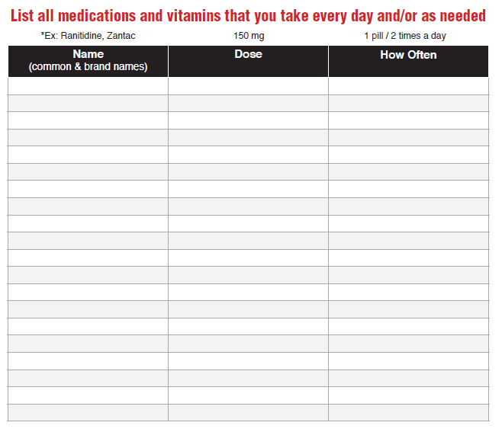
Medicine Trackers
Notes:
Now I want to show you something that could have really helped Judy out, both for giving her doctor that complete list of all of her medicines, AND for reminding her what she should ask the doctor about that new medicine he prescribed for her. Does anyone keep a list of all the different medicines they take?
Participants may mention doctors’ printouts; point out that those are very convenient but may not list all of the medicines prescribed by their other doctors. Participants should keep a list of all medicines prescribed by all of your doctors, plus any OTCs, vitamins, and supplements.
A medicine tracker is a really useful tool to help you make sure that you, every doctor that you see, and anyone that helps you with your medicines knows about all of the medicines you are taking. It can also help you make sure you take the right medicine at the right time every day. It has a place for the name of the medicine, why you take it, when you are supposed to start and stop taking it, how much you’re supposed to take (also called the “dose,”) and what time of day you’re supposed to take it. Why could something like this have helped Judy?
Discuss; ensure the following points are made:
If Judy has an up-to-date list of her medicines with her whenever she goes to a doctor or pharmacy, she won’t have to remember them all.
Plus, most doctors’ offices will make a photocopy of it and put it in her chart so she won’t have to write them all out.
Why is it important that each of your doctors knows about all of your medicines, even the ones he or she didn’t prescribe for you?
Discuss; ensure the following points are made:
Many medicines should not be taken with other kinds of medicines and vitamins. If your doctor doesn’t know about all of the medicines, vitamins, and supplements you’re taking, he or she may prescribe something that could interact with a medicine another doctor prescribed.
Keep the Poison Help number and the numbers for all of your doctors and your pharmacy in one place, preferably on an up-to-date list of all of the medicines that you take, so you have the numbers ready to call if you have questions.
What should Judy ask her doctor about the new medicine that he prescribed?
What’s my medicine called and what does it do?
How and when should I take it? And for how long?
What if I miss a dose?
Are there any side effects?
Is it safe to take it with other medicine or vitamins?
Can I stop taking it if I feel better?

Slide 19
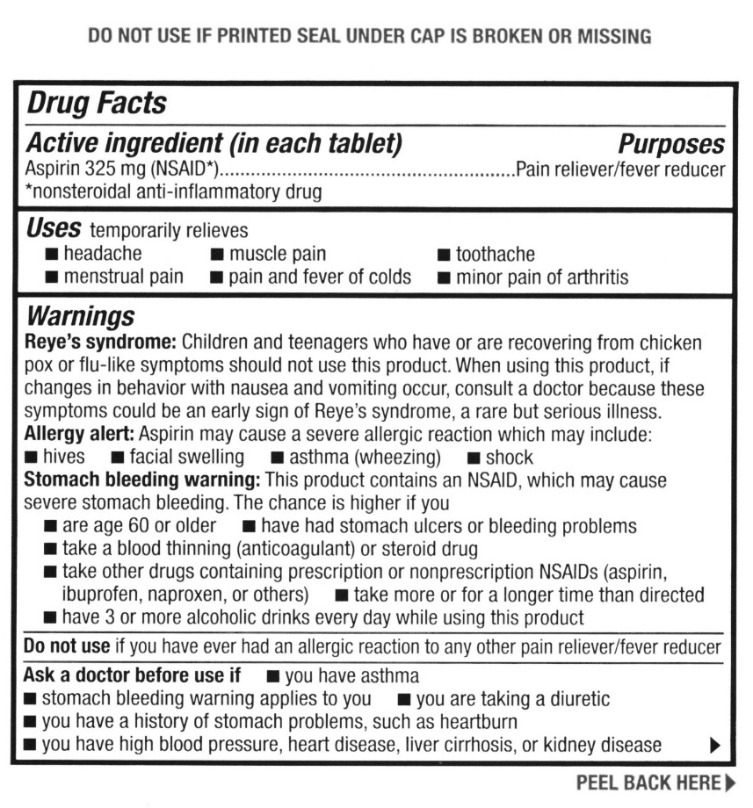
All over-the-counter meds have a Drug Facts label.
Notes:
Starting a new over-the-counter medicine - Covers being an active participant), following labels and instructions, writing down medicines, and being prepared by knowing who to call
Read or paraphrase: “One of Ron’s daily medicines is warfarin, which is a type of blood thinner. One day, Ron sees an advertisement on TV for aspirin. The commercial says that people should take an aspirin a day to help prevent heart attacks. Ron doesn’t want to have a heart attack so he drives to the pharmacy to purchase some aspirin. He thinks it’s safe because he’s taken aspirin before. Is there anything Ron should do before he purchases and starts taking the aspirin? Why?”
Discuss; ensure the following points are made:
It’s important to read and follow the entire Drug Facts label to understand if the medicine is appropriate for him, and if so, how it should be taken. The label can be complex and the font is small, so Ron should also check with the pharmacist, call the Poison Center, or check with his doctor before taking the aspirin if he has any questions.
As we age, medicine affects us differently than it did when we were younger, and our risk of adverse drug events goes up. Also, as we age, we are likely to be taking more medicines that can increase the chance of drug interactions. So, just because you took a certain medicine before doesn’t mean it’s still safe to take it now.
Ron should bring his medicine tracker to the pharmacy, or have it handy if he calls the Poison Center. This will help the pharmacist make sure he isn’t taking anything that could interact with the aspirin. Remember to write down any new medicines, even over-the-counter medicines, on your medicine tracker.
If possible, get all of your prescription medicines from one pharmacy. This way, the pharmacist can check your prescription medicines to make sure an over-the-counter medicine is safe for you to take with your current prescription medicines.
Read or paraphrase: “This is an example of the Drug Facts Label on aspirin. I know you can’t read it from where you’re sitting, so I’m going to read part of it for you. (Point to the sections marked by the red arrows.) “Under the ‘Warnings’ section, it says, ‘Stomach bleeding warning: this product contains an NSAID, which may cause severe stomach bleeding. The chance is higher if you take a blood thinning or steroid drug.’ Then, it says, ‘Ask a doctor before use if the stomach bleeding warning applies to you.’ Based on what I just read, should Ron take the aspirin?”
Discuss; ensure the following points are made:
Drug-drug interactions happen when two or more medicines react with each other to cause unwanted and sometimes very serious side effects. This kind of interaction can also cause one medicine to not work as well or even make one medicine stronger than it should be.
There is a bigger risk of medicine interactions for older adults.
It’s important to always read and follow the entire Drug Facts Label.
If a medicine comes with a dosing device like a cup or syringe, always use that dosing device to measure that medicine. Never use kitchen spoons to administer medicine. The amount of medicine you should take (dose) is calculated very precisely, and household utensils like spoons are not precise enough measurement tools, so when you use them for medicine you don’t really know how much medicine you’re getting.

Slide 20
5 Things to Remember:
Participate! It’s your health.
Read & follow the entire label.
Write your medicines down.
Keep medicine up, away, & out of sight.
Be prepared: Know who to call.
Notes:
Thank you so much for your time and participation today. Let’s wrap up by reviewing those 5 things I asked you to remember, one more time. (Read each, ad lib core messages.)

Slide 21
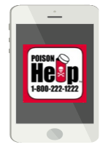
Poison Center Reminders
Open 24/7, even on holidays
All calls are free of charge
Pharmacists and poison information providers answer the phone
Notes:
Note: Remember to give participants Poison Help magnets, stickers, brochures, etc

Slide 22
MEDICINE SAFETY
with the Arizona Poison Control System
Thank you!!
Notes:
Note: If participants took a pre-test in the beginning of the presentation, please have them take a post-test.

